Slide 1
Software Design and Architecture
The Decorator Pattern and
Factory Method

Slide 2
Design principles
High-level principles
‣ Single Responsibility
‣ Open/Closed
‣ Liskov Substitution Principle
‣ Interface Segregation
‣ Dependency Inversion
Low-level principles
‣ Encapsulate what varies
‣ Program to interfaces, not implementations
‣ Favor composition over inheritance
‣ Strive for loose coupling

Slide 3
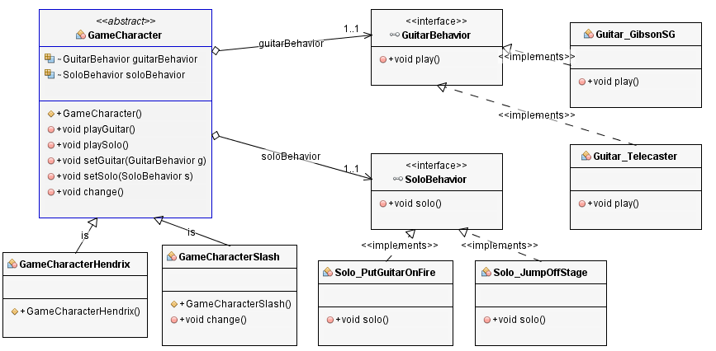
Lab 2 Task 3
Program to interfaces
Encapsulate what varies
Encapsulate what varies

Slide 4
Problem
Overuse of inheritance often leads to an explosion of classes

Slide 5
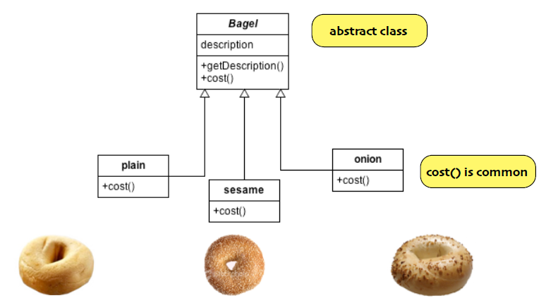
Example: Bagel Store

Slide 6
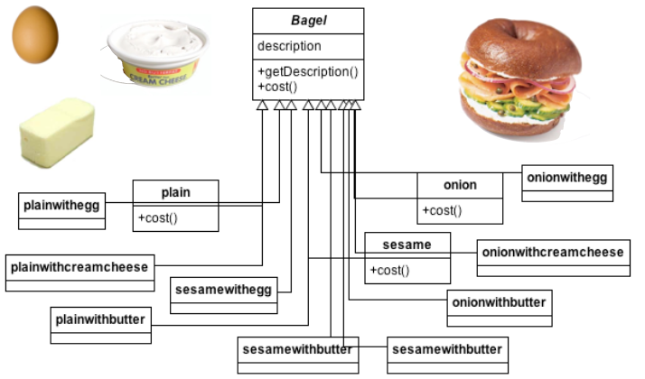
Class explosion

Slide 7
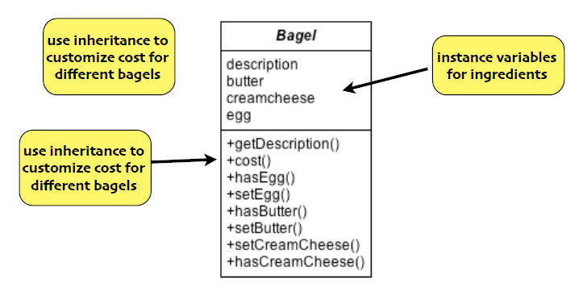
Alternative Design

Slide 8
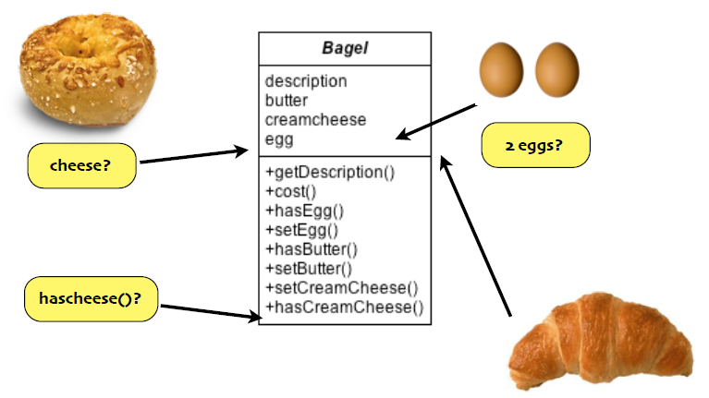
Disadvantages

Slide 9
Open-Closed Design Principle
Classes should be open for extension, but closed for modiﬁcation

Slide 10
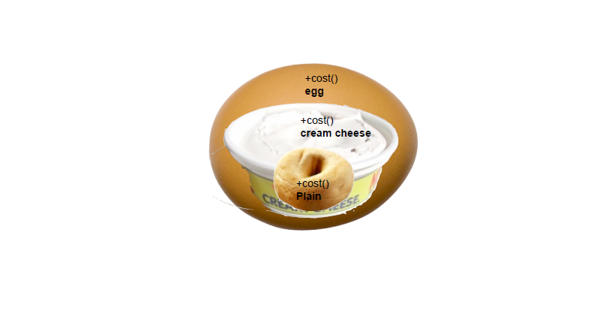
“Wrap” bagels with decorators
Bagel bagel = new Egg(new Chreamcheese(new Plain()));
System.out.println(" price: " + bagel.cost() + " dollars\n");

Slide 11
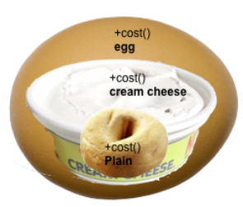
Delegation to access behavior
new Egg(new Chreamcheese(new Plain()));
1.egg.cost()
2.egg calls CC.cost()
3.CC calls plain.cost()
4.plain returns $plain
5.CC returns $plain + $cc
6.Egg returns $egg + ($plain+$cc)

Slide 12
Properties of Decorators
We have Objects and Decorators
Decorators have the same supertype as objects they decorate.
You can pass around a decorated object instead of the original.
The Decorator adds it’s own behavior before or after delegating to the object it decorates
Objects can be decorated dynamically at runtime

Slide 13
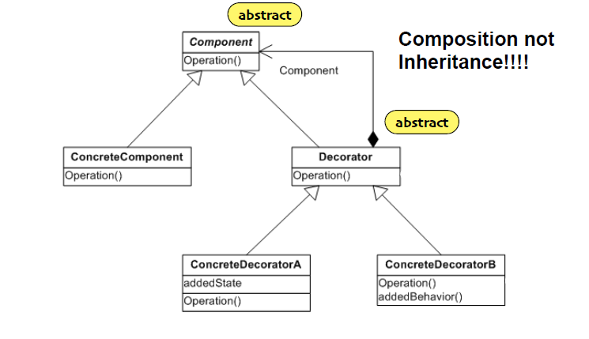
Class diagram

Slide 14
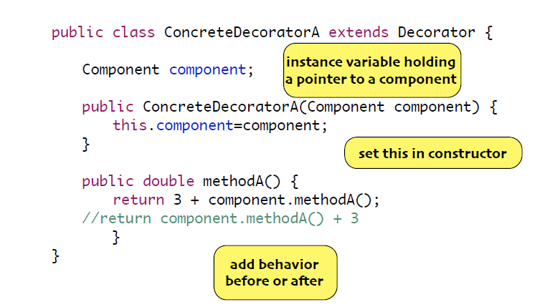
Decorator Class

Slide 15
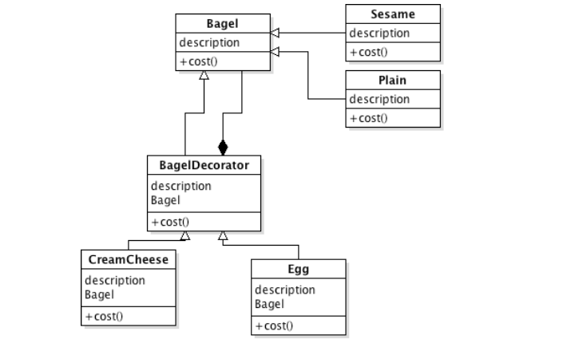
Class Diagram

Slide 16
The application
public class BagelStore {
public static void main(String[] args) {
Bagel bagel = new Plain();
bagel = new Chreamcheese(bagel);
bagel = new Egg(bagel);
System.out.println(bagel.getDescription() + " price: " + bagel.cost() + " dollars\n");
} }

Slide 17
Bagel Class
public abstract class Bagel {
String description = "unknown Bagel";
public String getDescription() {
return description;
}
public abstract double cost();
}
public class Plain extends Bagel {
public Plain() {
description = "Plain";
}
public double cost() {
return 1.00;
}}

Slide 18
Bagel Decorator
public abstract class BagelDecorator extends Bagel {
public abstract String getDescription();
}
public class Egg extends BagelDecorator {
Bagel bagel;
public Egg(Bagel bagel) {
this.bagel=bagel;
}
public String getDescription() {
return bagel.getDescription() + ", Egg";
}
public double cost() {
return .50 + bagel.cost();
}}

Slide 19
Pattern Categories
Behavioral Patterns : identify common communication patterns between objects
observer
strategy
decorator
Creational Patterns : deal with object creation mechanisms
factory method

Slide 20
The Problem with “new”
Each time we use the “new” command, we break encapsulation of type
Duck duck = new DecoyDuck();
Even though our variable uses an “interface”, this code depends on “DecoyDuck”
Lab 2 Task 2 Example:
GameCharacter player1 = new GameCharacterSlash();
GameCharacter player2 = new GameCharacterHendrix();

Slide 21
Problem
Too many dependencies to concrete classes makes your software diﬃcult to maintain and modify

Slide 22
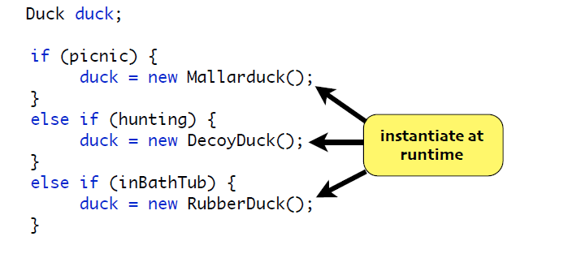
Example

Slide 23
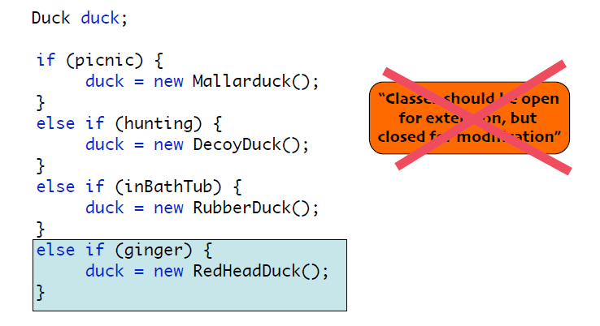
Adding a new duck

Slide 24
DESIGN PRINCIPLES
Dealing with CHANGE
Code to an interface and insulate yourself from changes {Strategy}
Identify aspects that vary and separate them from what stays the same. {Strategy}
Close your code for modification {Decorator}

Slide 25
public class PizzaStore {
Pizza orderPizza(String type) {
Pizza pizza;
if (type.equals("cheese")) {
pizza = new CheesePizza();
} else if (type.equals("greek")) {
pizza = new GreekPizza();
} else if (type.equals("pepperoni")) {
pizza = new PepperoniPizza();
}
pizza.prepare();
pizza.bake();
pizza.cut();
pizza.box();
return pizza;
}
}
Creation
Creation code has all the same problems as the
code earlier
Preparation

Slide 26
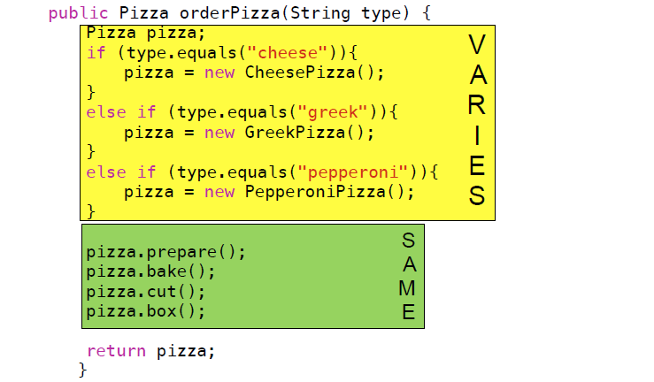

Slide 27
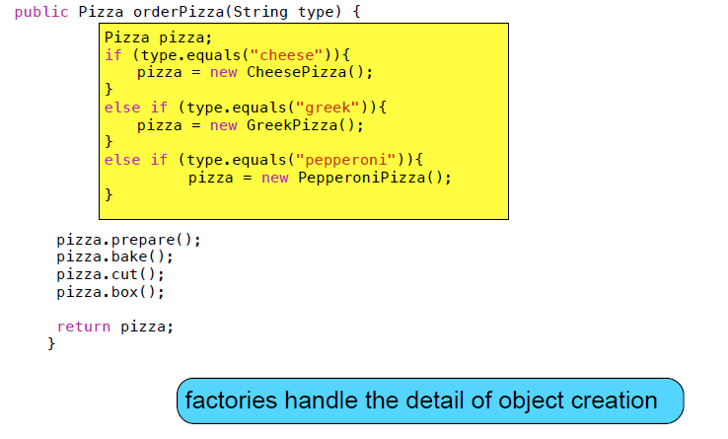
“Factor” Out

Slide 28
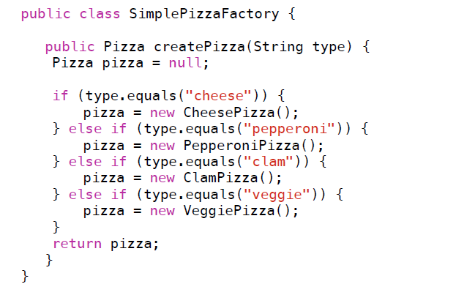
Pizza Factory

Slide 30
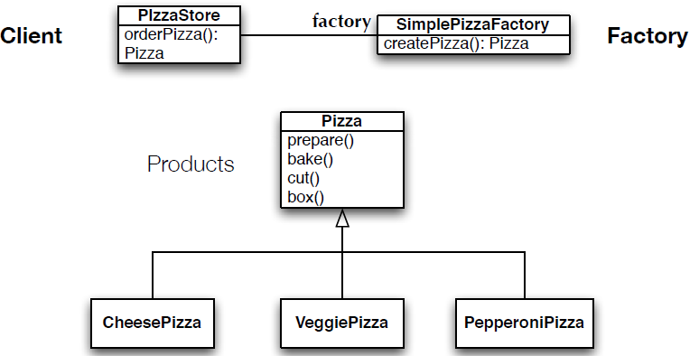
Class Diagram of New Solution

Slide 31
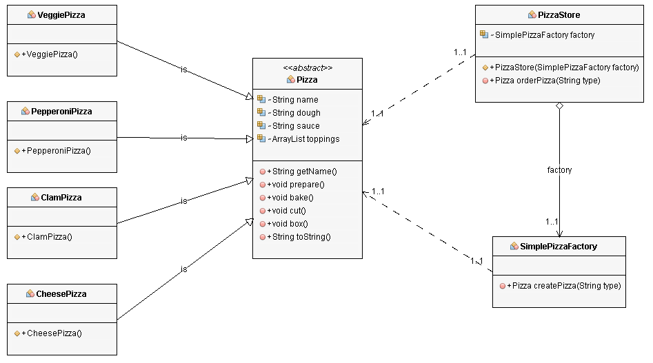
Class Diagram of New Solution

Slide 32
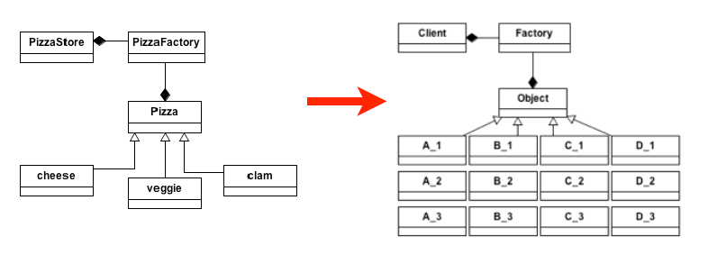
One step beyond
how can we support more variability?
support “families” of products?

Slide 33
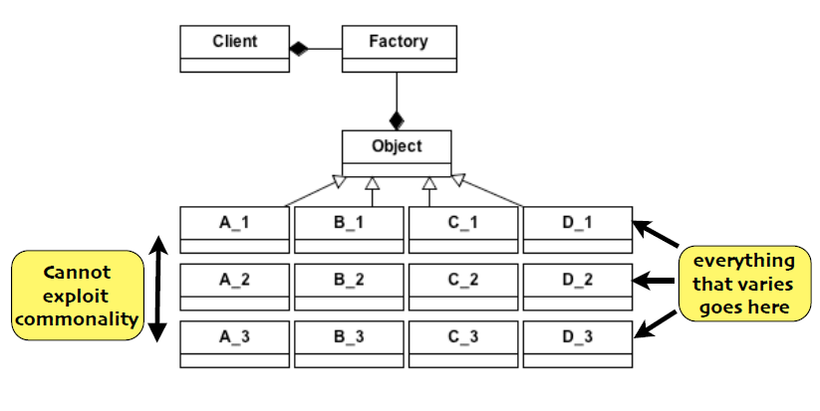
Problem

Slide 34
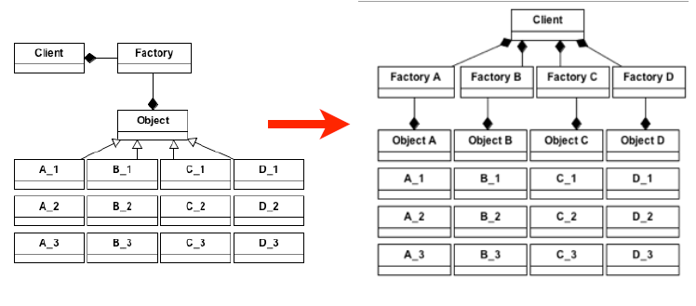
Subclass the Factory

Slide 35
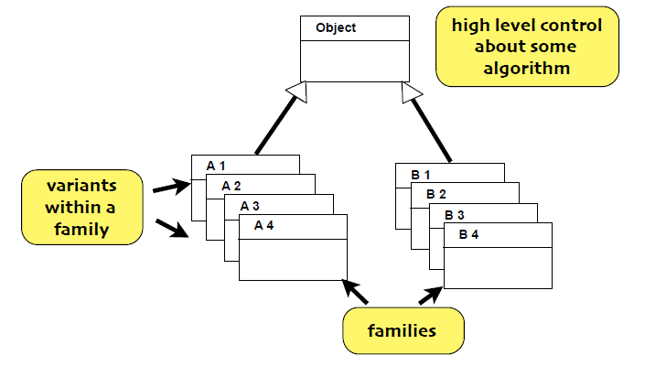
Product Class

Slide 36
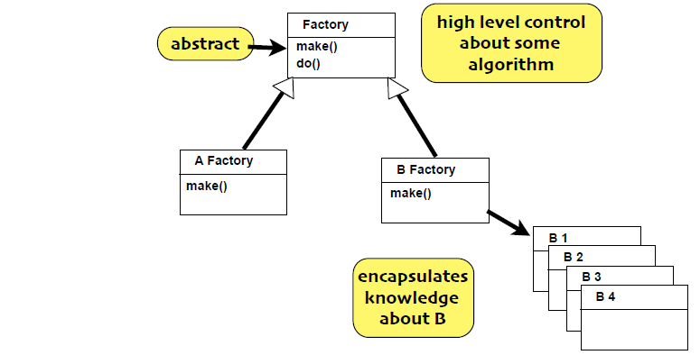
Creator Class

Slide 37
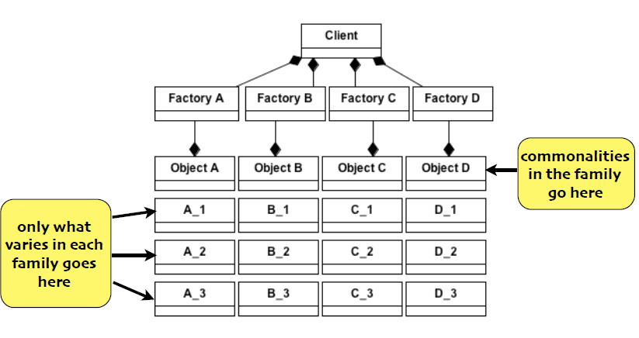
Benefits

Slide 38
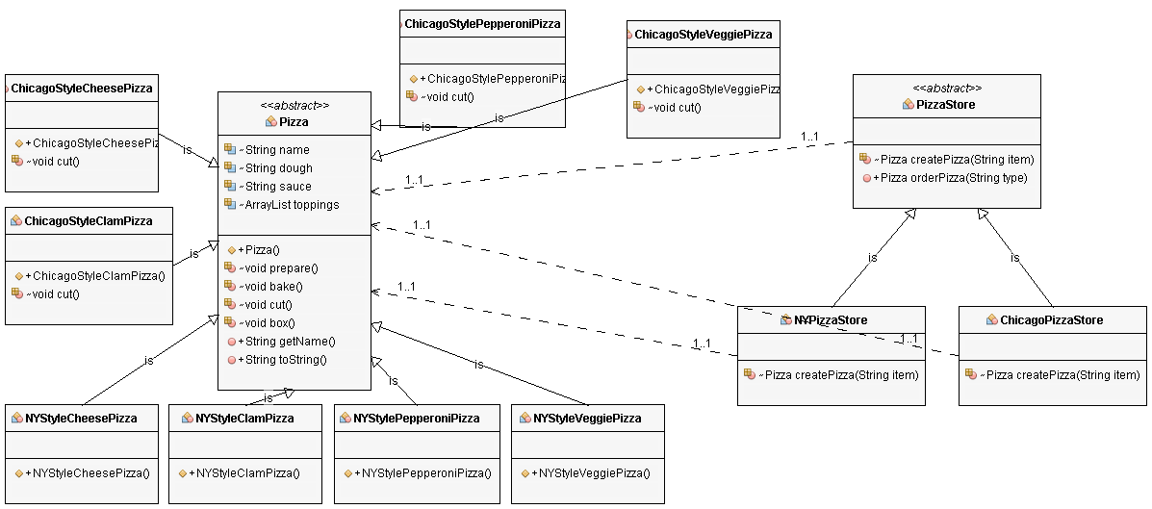
PizzaStore nyStore = new NYPizzaStore();
PizzaStore chicagoStore = new ChicagoPizzaStore();
Pizza pizza = nyStore.orderPizza("cheese");
System.out.println("Ethan ordered a " + pizza.getName() + "\n");
pizza = chicagoStore.orderPizza("cheese");
System.out.println("Joel ordered a " + pizza.getName() + "\n");

Slide 39
Factory Method Pattern
The Factory method Pattern defines an interface for creating an object, but lets subclasses decide which class to instantiate. Factory Method lets a class defer instantiation to subclasses

Slide 40
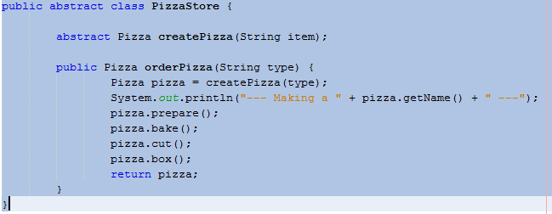
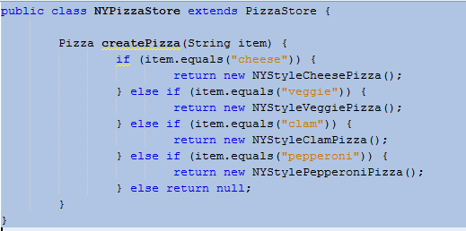
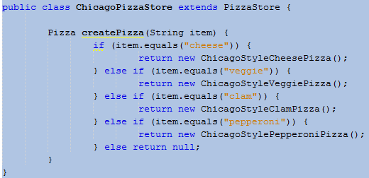

Slide 41
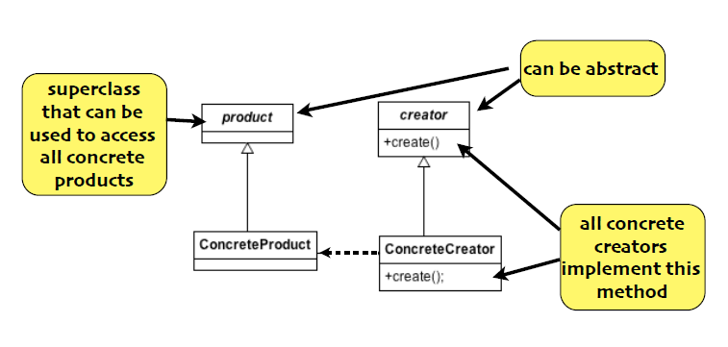
Factory method class diagram

Slide 42
Design principle
Dependency Inversion Principle

Slide 43
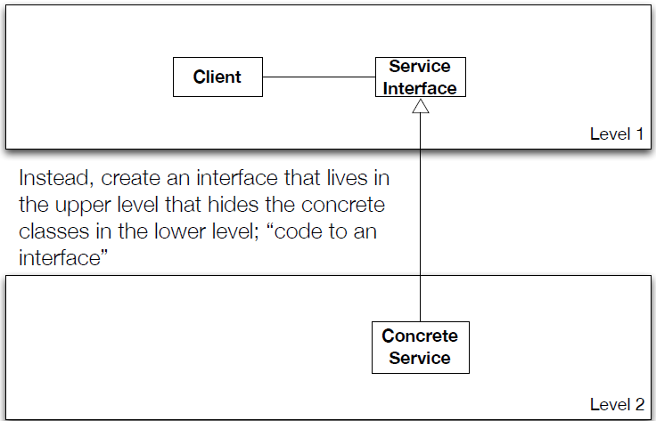
Design principle
Dependency Inversion Principle

Slide 44
Factory Method is one way of following the dependency inversion principle
“Depend upon abstractions. Do not depend upon concrete classes.”
In this design, PizzaStore (the high-level class) no longer depends on the Pizza subclasses (the low level classes); they both depend on the abstraction “Pizza”.

